Slide 1

Mental Health
Care in the ED
Lucy Vermeulen

Slide 2
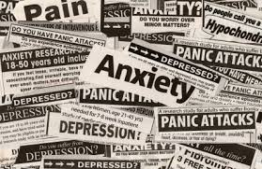
CDC statistics “indicate that 30%
of all ED cases treated in ED are
psychiatric in nature.”
Gagnon, 2010, p. 677

Slide 3
NENA Core Competencies: Mental Health
Knowledge of psychiatric emergencies specific to the adult/pediatric/geriatric populations
Selection of appropriate interventions to manage alterations in mental/behavioural health and ensure patient and staff safety
Knowledge of protocols, guidelines, and laws pertaining to patients with mental/behavioural health illnesses
Recognition of escalating behaviour
NENA, 2014

Slide 4
NENA Core competencies: mental Health
Recognition of delirium, dementia, and depression in the geriatric population
Knowledge and interventions for mood and personality disorders, anxiety and stress disorders, eating disorders, schizophrenia
Knowledge of suicidal risk assessment
NENA, 2014

Slide 5
Nena core competencies: Psychosocial
Provides effective and timely communication to the patient and significant others
Ensures environment that promotes privacy and support
Knowledge of crisis intervention as it relates to the patient, family and significant others
Provision of reassurance, acceptance and encouragement during times of stress
NENA, 2014

Slide 6
Nena core competencies: psychosocial
Recognition of signs of abuse in the pediatric/elder/vulnerable patient
Recognition and knowledge of intimate partner violence
Knowledge of cultural awareness and sensitivity
NENA, 2014

Slide 7

What Do Mental Health Patients Look Like?
Fiction

Slide 8

What Do Mental Health Patients Look Like?
Reality
The intelligent
Me
You
Look in
the mirror!
The rich
The homeless
Anyone!

Slide 9
Mental Health Crisis
“A crisis can refer to any situation in which the individual perceives a sudden loss of his or her ability to use effective problem-solving and coping skills”
Encyclopedia of Mental Disorders, 2014

Slide 10
Assessment
Safety: remove all weapons, items with which patient
can harm self or others
History of presenting complaint
Behavioral changes
Somatic symptoms
Thought disturbances
Thoughts of harming self or others
Precipitating event
Home treatment

Slide 11
Assessment
Past History
Objective assessment
Level of consciousness
Vital signs
Behavior
Affect
Appearance
Speech pattern
Notes:
Behaviour: anxious, tearful, agitated, withdrawn, flat, angry, abusive, combative, disoriented, confused, inappropriate
Affect: expression of mood
Speech pattern: tangential, word salad, mumbled, minimal, rapid,

Slide 12
Form 1/42
Form 1 – a legal document in which patient is deemed at significant risk of self harm, harming others, or incapable of caring for self. Patient must be evaluated by psychiatry.
Length of validity – 72 hours
Photocopy is invalid; if incomplete, deemed invalid.
If unaccompanied by Form 42, Form 1 is
deemed invalid.
Form 42 – Document informing the patient of their
involuntary status.

Slide 13
Patients placed on Form 1
All formed patients require continuous observational while in ED (might be done by RN, family, observational care, security, guards, police)
An involuntary pt. cannot necessarily be forced to take medications!
An involuntary pt. can be restrained as last resort only.

Slide 14
Suicide risk assessment
Distinguish between self-harm and suicidal intention
Warning Signs:
Threatening suicide
Seeking or access to means
Evidence or expression of plan
Hopelessness, rage
Reckless, impulsive or risky behaviours
Expressing feeling of being trapped with no way out
Perlman, Neufeld , Martin , Goy, & Hirdes 2011
Notes:
was the intention of the behaviour to end the person’s life, a call for help, or a means of temporary escape?
Expressing hopelessness is fairly strong predictor of suicide (Perlman et al.)

Slide 15
Suicide risk assessment
Increasing or excessive substance use
Withdrawing from family, friends & society
Anxiety, agitation, abnormal sleep
Dramatic mood changes
Expresses no purpose in living
Perlman et al., 2011
Notes:
Persons who abuse alcohol or other substances may also be at increased risk of suicide, particularly as inhibitory control is reduced and impulsivity is increased

Slide 16
Suicide: Risk Factors
Recent job loss or financial difficulties
Divorced, separated, widowed
Social isolation
Prior traumatic life events or abuse
Previous suicide behaviour
Chronic mental illness
Chronic debilitating physical illness
Perlman et al., 2011
Notes:
A history of mental illness has been found to be a much stronger predictor of suicide than socioeconomic variables
about 5% of persons with schizophrenia died by suicide
But up to 50% of persons with schizophrenia consider suicide at some point in their lifetime
90% of persons who have died by suicide in the United States had depression, substance abuse, and other mental illnesses A history of mental illness has been found to be a much stronger
predictor of suicide than socioeconomic variables
(Perlman et al., 2011
Among persons with schizophrenia, it is important to review whether hallucinations are contributing to a person’s suicidal ideation or desire to die

Slide 17
Specific emergencies
Mood disorders
Anxiety disorders
Thought disorders
Situational crises
Suicide

Slide 18
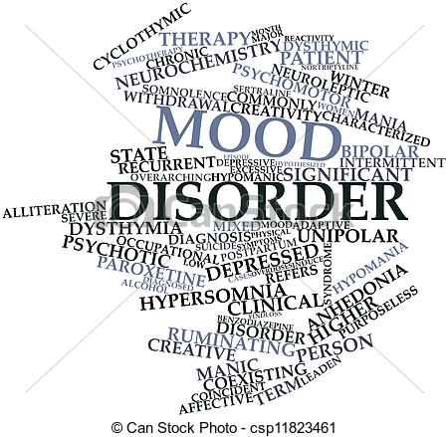
Mood Disorders
Depression
Bipolar illness
Post-partum depression
Seasonal affective disorder

Slide 19
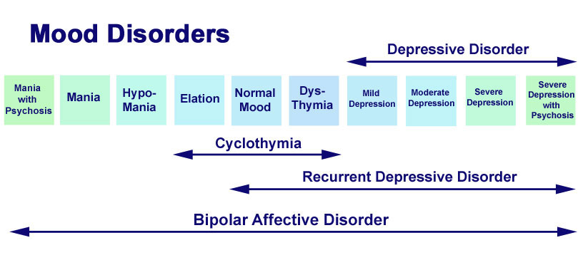
The continuum of bipolar depression

Slide 20
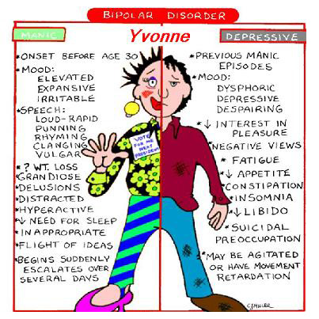

Slide 21
mania
An abnormally elevated mood
Feelings of euphoria
Loud, rapid, excessive speech
Inability to concentrate
Dec. need for sleep
Impulsivity
Poor judgment
Inappropriate behavior
Increased energy levels
Increased sexual desire
Notes:
Hypomania: slight mania that typically does not require hospitalization

Slide 22
depression
“An overwhelming despair so bleak that people
who have experienced it say that it is the worst pain they have ever endured”.
Profound sadness
Inc,/dec sleep & weight
Inability to concentrate
Dec. interest in pleasurable activities
May be preoccupied with thoughts of suicide
Mood Disorders Society of Canada, 2013

Slide 23
Manic Depression: Treatment
Ensure safety
Monitor, monitor, monitor
May require de-stimulation
Quiet room
Limited visitors
Sedatives

Slide 24
Medications
Antidepressants
SSRIs – Celexa, Zoloft, Paxil
Dual uptake inhibitors –
Venlafaxine,
Pristiq,
Cymbalta
Mood Stabilizers
Anti-convulsants
Valproic acid,
carbamazepine,
Lamotrigine
Lithium
Notes:
May need to be supplemented with antipsychotic

Slide 25
Serotonin syndrome
Increased serotonic activity in CNS
Associated with mental status changes,
autonomic hyperactivity,
neuromuscular dysfunction
Boyer, 2014
Notes:
In the central nervous system (CNS), serotonin modulates attention, behavior, and thermoregulation. Serotonin is also found in platelets where it promotes platelet aggregation
Hyperthermia
●Agitation
●Slow, continuous, horizontal eye movements (referred to as ocular clonus)
●Dilated pupils
●Tremor
●Akathisia
●Deep tendon hyperreflexia (common)
●Inducible or spontaneous muscle clonus (common)
●Muscle rigidity
●Bilateral Babinski signs
●Dry mucus membranes
●Flushed skin and diaphoresis
●Increased bowel sounds
Symptom management
May need to sedate with benzos
Antidote: serotonin antagonist: Cyproheptadine

Slide 26
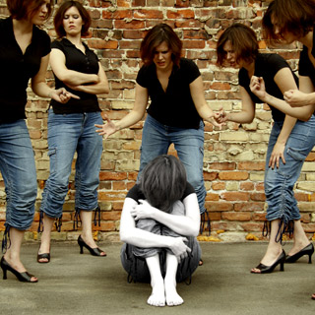
Thought Disorders

Slide 27
Thought Disorders
“A person with psychosis experiences some loss
of contact with reality, characterized by
changes in their way of thinking, believing, perceiving
and/or behaving”
Canadian Mental Health Association, 2013
“Psychosis refers to a loss of contact with reality”
Centre for Addiction and Mental Health, 2012
Notes:
http://www.cmha.ca/mental-health/understanding-mental-illness/psychosis/

Slide 28
Thought Disorders
Disorganized or dysfunctional ways of thinking
Schizophrenia: onset usually late teens
Schizoaffective
Drug-induced psychosis: onset with drug ingestion
(symptoms may/may not resolve after drug wears off)

Slide 29
Symptoms: Delusions
false beliefs
“God told me to….”
“I am being followed by….”
persecutory delusions
paranoid delusions
delusions of grandeur

Slide 30
Symptoms: hallucinations
Sensory perceptions that are not real
“hearing voices”
“seeing spiders”
based on the senses

Slide 31
Treatment
Safety of patient and environment
Early intervention: PEPP
Antipsychotics

Slide 32
Antipsychotics
Typical
Older antipsychotics
Haloperidol
Loxapine
CPZ, Modecate
Have significant risk for
parkinsonian-like effects.
Notes:
The main difference between the two types of antipsychotics is that the first generation drugs block dopamine and the second generation drugs block dopamine and also affect serotonin levels. Evidence suggests that some of the second generation drugs have milder movement- related side-effects than the first generation drugs. (CAMH, 2009)
Usually second choice for treatment b/c of significant movement effects – can be treated with Benzotropine
5% will get tardive dyskensia (repetitive involuntary movements). The risk is highest with the first generation antipsychotics, although it can occur with the second generation drugs.
Dec. sexual desire, Dizziness,

Slide 33
antipsychotics
Atypical
2nd generation
Olanzapine, Seroquel
Clozapine, Rispirodone
Risk for weight gain, diabetes
Notes:
The main difference between the two types of antipsychotics is that the first generation drugs block dopamine and the second generation drugs block dopamine and also affect serotonin levels. Evidence suggests that some of the second generation drugs have milder movement- related side-effects than the first generation drugs. (CAMH, 2009)

Slide 34
Acute dystonic reaction
https://www.youtube.com/watch?v=76yyO9G9oZQ
Treatment: IV Benadryl
IV Cogentin/Benzotropine (MD)

Slide 35
Neuroleptic malignant syndrome
A rare but life-threatening reaction to antipsychotics
whose symptoms include fever, muscle stiffness
delirium and autonomic dysfunction.
NORD, 2015
Notes:
wide swings of blood pressure, excessive sweating and excessive secretion of saliva.
Treatment is symptomatic.
Once patients have recovered from neuroleptic malignant syndrome, about 87% will be able to tolerate an antipsychotic at some point in the future

Slide 36
Personality disorders
“a lifelong pattern of irresponsible behaviour and demonstrate little concern for the rights of others, the norms of society, the dictates of conscience, and the law”
CMHA, 2015

Slide 37
10 Personality Disorders
Cluster A: paranoid, schizoid and schizotypal personality disorders. These are characterized by feeling paranoid, distrustful and suspicious.
Cluster B: impulsive personality disorders, such as borderline, narcissistic, histrionic and antisocial personality disorders. These are characterized by having difficulty controlling emotions, fears, desires and anger
Cluster C: anxious personality disorders, such as obsessive-compulsive, dependent and avoidant personality disorders. These are characterized by experiencing compulsions and anxiety.

Slide 38
Antisocial
Borderline
Narcissistic
Histrionic

Slide 39

Anxiety disorder
A chronic condition characterized by an excessive and persistent sense of apprehension, with physical symptoms such as sweating, palpitations and feelings of stress.

Slide 40
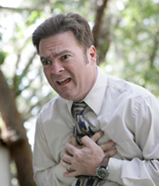
Anxiety disorder
Generalized anxiety disorder
Obsessive-compulsive disorder
PTSD
Panic
Agoraphobia

Slide 41



Eating disorders
“…all-consuming preoccupation with calories,
grams of fat, exercise and weight allows them to
displace the painful emotions or situations that are
at the heart of the problem and gives them a false
sense of being in control.”
CMHA, n.d.
Notes:
Anorexia nervosa
Bulimia
Binge-eating

Slide 42


Situational crisis
“an unexpected crisis that arises suddenly in response to an external event or a conflict concerning a specific circumstance. The symptoms are transient, and the episode is usually brief”.
Mosby, 2009

Slide 43
Nursing care
Emergency care

Slide 44

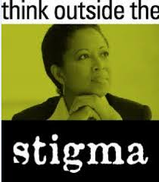
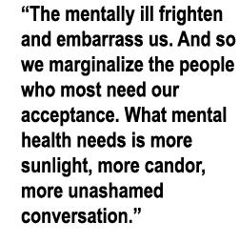
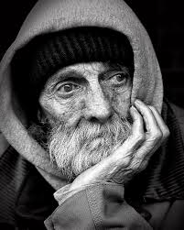
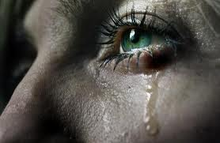
The problem with mental illness
Notes:
Judgment free

Slide 45
Therapeutic relationship
Judgment-free
Listen
Private environment
Role model desired behaviours (i.e. calm voice)
Help patient see his/her strengths
Develop trust

Slide 46
What must you do?
Ensure safety for all
Monitor at least q1hr; more often if unstable
Don’t assume MH is the reason for visit***
Document an assessment at least q shift
Treat your patient like you want to be treated

Slide 47
References
Boyer, E. (2014). Serotonin Syndrome. UpToDate. Retrieved April 29, 2015 from
http://www.uptodate.com/contents/serotonin-syndrome
Canadian Mental Health Association (n.d.). Eating Disorders. Retrieved April 30, 2015 from
https://www.cmha.ca/mental-health/understanding-mental-illness/eating-disorders/
Canadian Mental Health Association (2013). Psychosis. Retrieved Jan. 20, 2014 from
http://www.cmha.ca/mental-health/understanding-mental-illness/psychosis/
Canadian Mental Health Association (2015). Personality Disorders. Retrieved April 29, 2015 from
https://edmonton.cmha.ca/mental-health/understanding-mental-illness/personality-disorders/
Centre for Addiction and Mental Health (2012). What is Psychosis? Retrieved Jan. 20, 2014
from http://www.camh.ca/en/hospital/health_information/a_z_mental_health_and_
addiction_information/psychosis/Pages/Psychosis.aspx

Slide 48
references
Encyclopedia of Mental Disorders (2014). Crisis Intervention: Definition. Retrieved
January 16, 2014 from http://www.minddisorders.com/Br-Del/Crisis-intervention.html
Gagnon, L. (2010). Behavioral Health Emergencies. Sheehy’s Emergency Nursing Principles
and Practice, 6th ed. Missouri: Mosby Elsevier
Mood Disorders Society of Canada. (2013). What is Depression? Retrieved April 29,
2015 from http://www.mooddisorderscanada.ca
/documents/Publications/DepressEngMaster_v18_Nov_2013.pdf?utm_source=
Google&utm_medium=cpc&utm_content=DepressionFacts&utm_campaign=
Depression&gclid=CMT4waj_m8UCFREoaQod5KMAFA
Mosby's Medical Dictionary, 8th edition. © 2009, Elsevier

Slide 49
references
National Emergency Nurses Association (2014). Standards and Practices:
Emergency Nurses Core Competencies. Retrieved April 29, 2015 from
http://nena.ca/w/wp-content/uploads/2014/11/NENA-Core-Competencies.pdf
National Organization for Rare Disorders. (2015). Neuroleptic Malignant Syndrome.
Retrieved April 29, 2015 from https://www.rarediseases.org/rare-disease-
information/rare-diseases/byID/763/viewAbstract
Perlman CM, Neufeld E, Martin L, Goy M, & Hirdes JP (2011). Suicide Risk
Assessment Inventory: A Resource Guide for Canadian Health care
Organizations. Toronto, ON: Ontario Hospital Association and Canadian
Patient Safety Institute

